Slide 1
IBM BPM Admin Tools
Juan Camilo Parra
IBM Cloud Consultant
jcparra@co.ibm.com

Slide 2
IBM BPM Admin Tools
Installation

Slide 3
Overview
BPMAdminTool is a set of helping tools intent to make easier the administration of IBM BPM version 8.0.3 or upper.
It was created based on 5 years experience with customer on Latin America, knowing their principals administration issues, extending functionality about most typical administrative tasks.
Use this tools at your own risk.

Slide 4
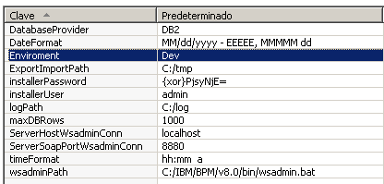
Configure Environment Variables
Configure with Process Designer on Process Center.
And with Process Admin on Process Server.

Slide 5
Installation
To install use and follow typical installation of a Snapshot (Import first on Process Center as normal Process App)
https://www.ibm.com/support/knowledgecenter/SS964W/com.ibm.wbpm.admin.doc/topics/deploying_introduction.html
After Install Configure Environment Variables

Slide 6
Variables
DataBaseProvider: Only support ORACLE or DB2 as parameters, it depends if your BPM installation is Oracle or DB2
DateFormat: It is used on fully dates, as represent holidays.
Enviroment: Usually you don’t need to modify it, it depends on environment type Dev, Stage, Test, Prod.
ExportImportPath: Path on server to export or search for snapshots to install, this property is used by Export/Import Snapshot.
installerUser: Administrative user with role tw_admins used to execute wsadmin commands on environment.
installerPassword: Password of installerUser, it can be encripted used xor algorithm http://www.sysman.nl/wasdecoder/
logPath: All wsadmin commands are going to generate logs on that path
maxDBRows: use to limit number of rows returned by consults (Instance Manager, max instances returned)
ServerHostWsadminConn: server to execute wsadmin commands, usually localhost (execute on same server it was launched) but you can change to always execute on a particular server.
ServerSoapPortWsadminConn: Soap port on server launched.
timeFormat: Format time used on vacations, and schedule.
wsadminPath: path to launch wsadmin.sh or wsadmin.bat it has to be same on all servers, so we recommend to use bin/wasadmin from WAS installation path

